Slide 1
North Dakota Atlas
Lindsey Wingate

Slide 2
Project
Web Design
Overhaul of current ndatlas page
http://ndatlas.und.edu/

Slide 3
Currently
Moving all files from test server to NDAtlas server.
Finalizing details on each page
Need a few more pages to be designed and coded
Need new navigation menu

Slide 4


Slide 5


Slide 6
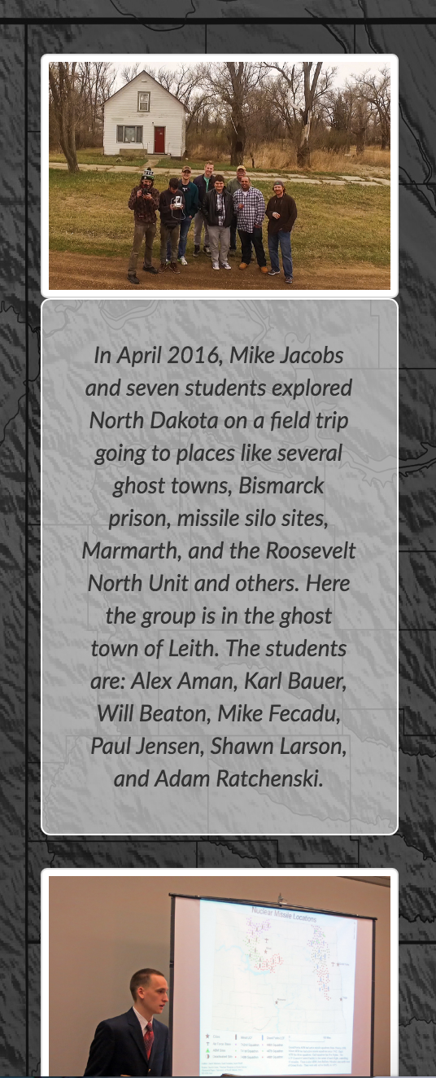
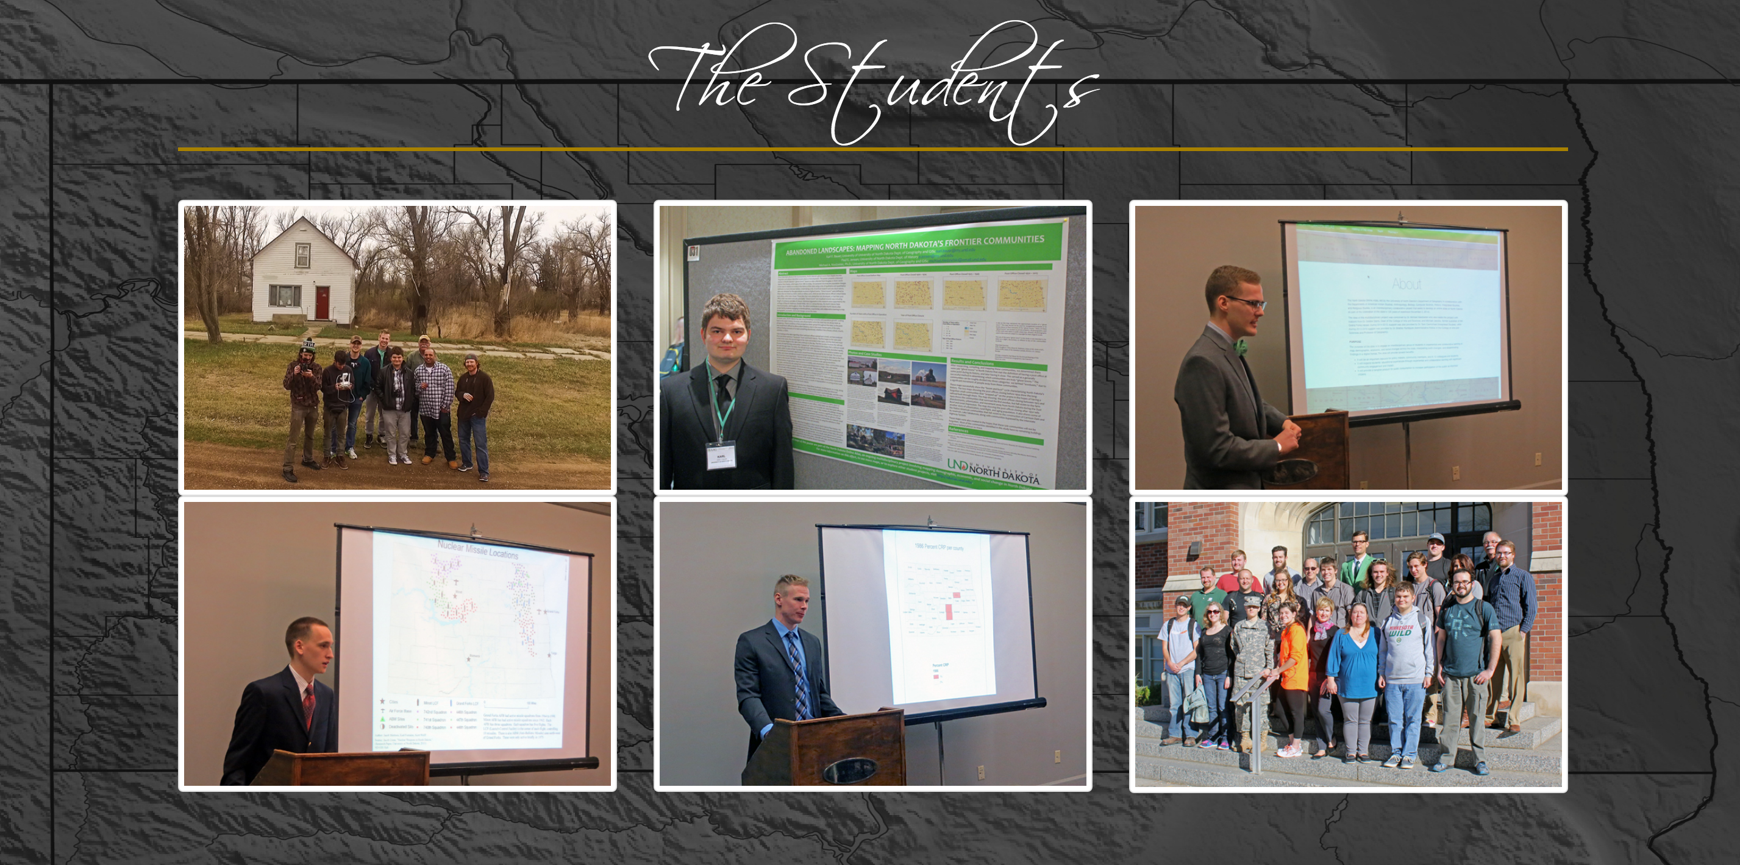

Slide 7
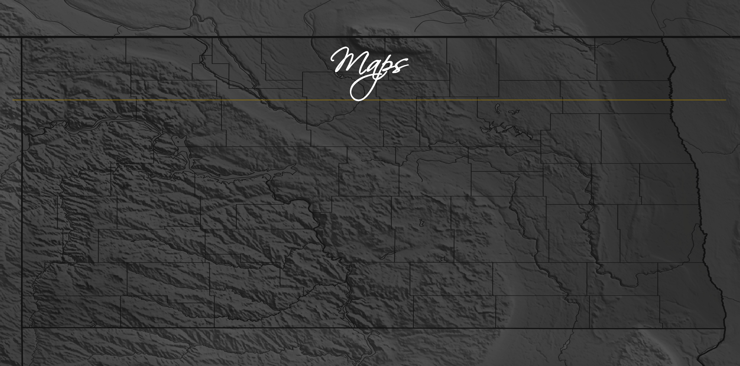
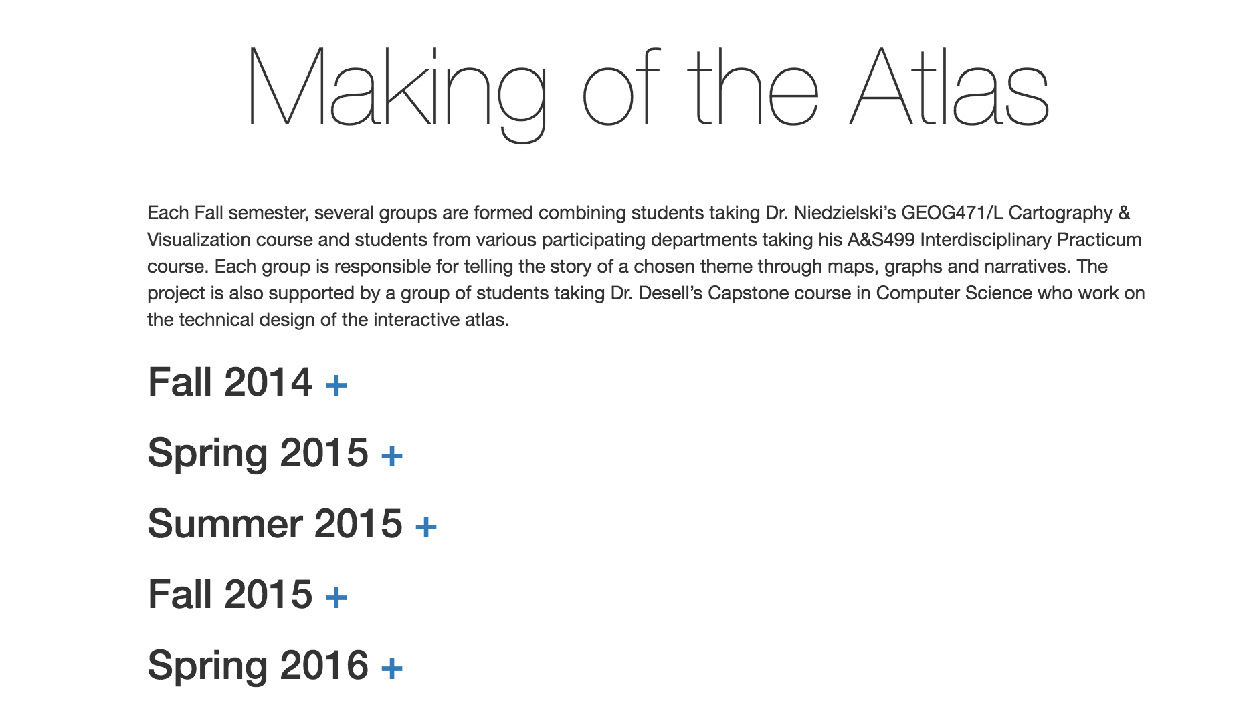
Some details about the project history
Map Table of Contents

Slide 8
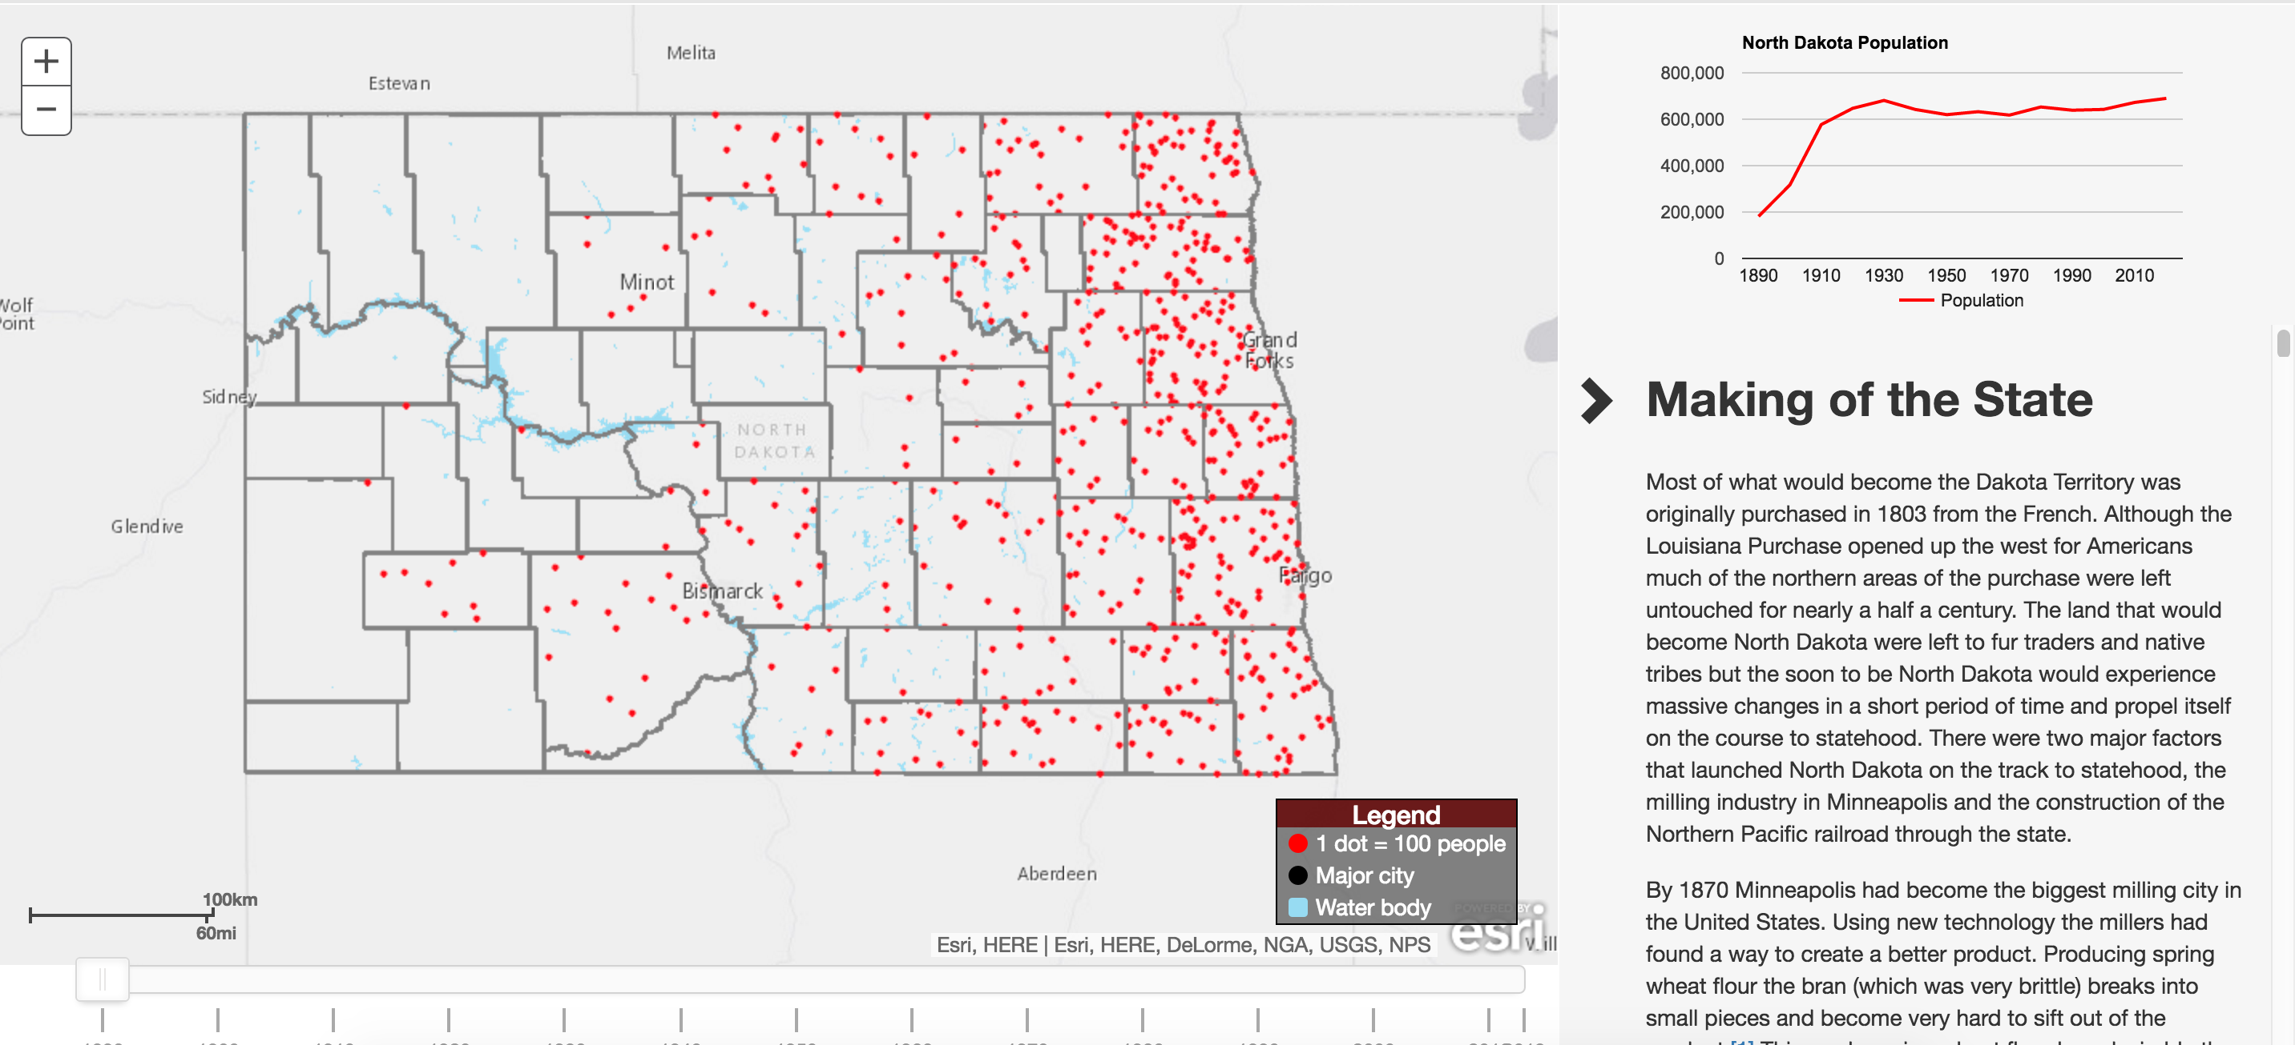

Slide 9
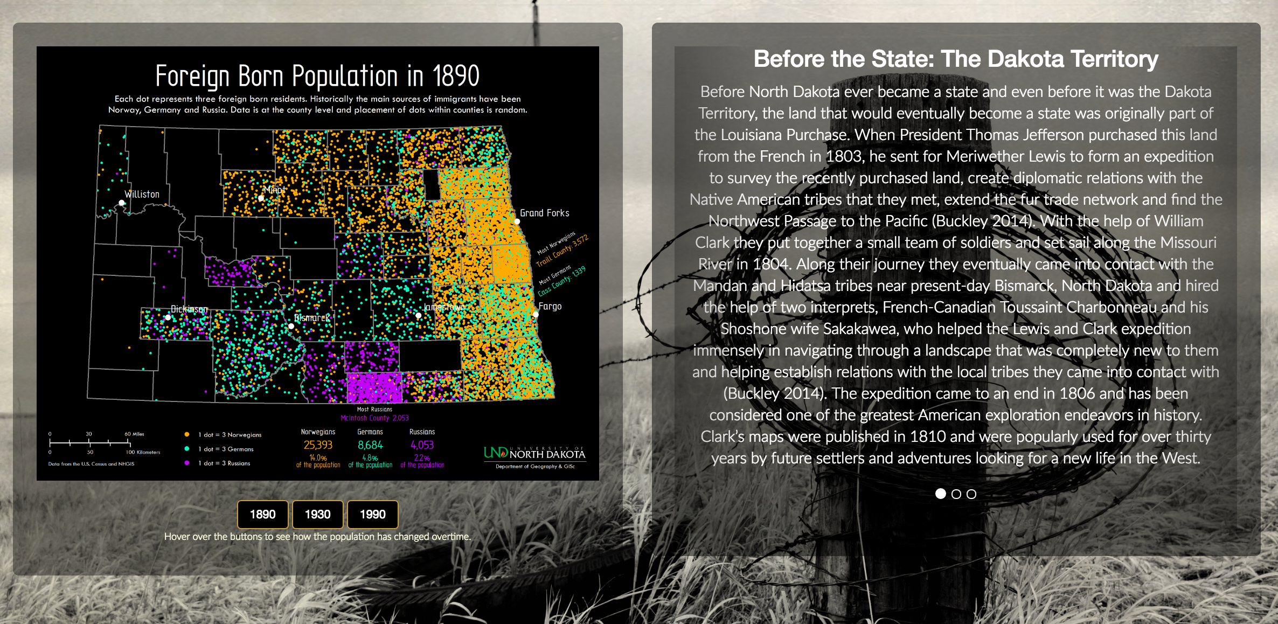
*I have issues with this page: carousel doesn’t work, resizing boxes makes content uneven, map needs to be bigger

Slide 10
Future Progress
Get permissions for Git/make forked code live
Next Semester:
-More advanced maps with interactive JS
-Expansion plans

